Slide 1
ME5402 / EE5106 / EE5064
ME5402 / EE5106: Advanced Robotics: Part II- Dynamics and Control
EE5064: Dynamics and Control of Robotic Manipulators
Shuzhi Sam Ge, FIEEE, PhD, DIC, BSc
Department of Electrical and Computer Engineering
National University of Singapore
Singapore 117576
E-mail: samge@nus.edu.sg / Tel: 6516 6821 / Office: E4-05-28
https://blog.nus.edu.sg/srlweb
Online/ Schedule: 6.00-9.00pm, Monday / Weeks 7- 12+

Slide 2
References
[1] Craig J.J., Introduction to Robotics, Mechanics, and Control, 3nd Ed., Pearson Education, 2005
[2] Ge S.S., Lee T.H. and Harris C.J., Adaptive Neural Network Control of Robotic Manipulators, World Scientific, London, December 1998
[3] Fu K.S., Gonzalez R.C., and Lee C.S.G, Robotics: Control, Sensing, Vision and Intelligence, McGraw-Hill, NY, 1987
[4] Sciatica, L. and Siciliano, B., Modeling and Control of Robot Manipulators. 2nd Edition Springer Verlag, 2000.
[5] Li, Z.J. and Ge S.S., Fundamentals in modeling and control of mobile manipulators, CRC Press, Taylor and Francis Group, 2013.
Lecture Resources: https://luminus.nus.edu.sg

Slide 3
Course Outline
Review of Kinematics
General features of robots
Formulation of Denavit - Hartenberg
Direct kinematics and inverse kinematics
Robot Dynamics
Newton-Euler formulations
Lagrange-Euler formulation
Properties of dynamic models
Tutorials of dynamics
Neural network modelling

Slide 4
Course Outline
Position and Trajectory Control
Fundamentals
Single-joint position control
Multi-joint position control
Adaptive control
Robot Force Control
Force control and hybrid position/force control
Impedance control and intelligent control
Control of constrained robots

Slide 5
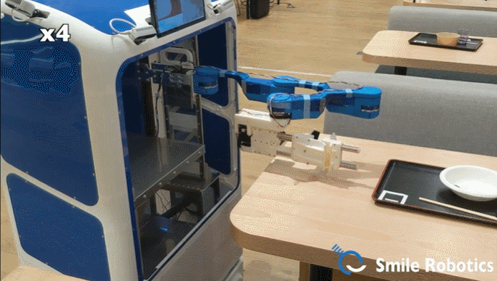
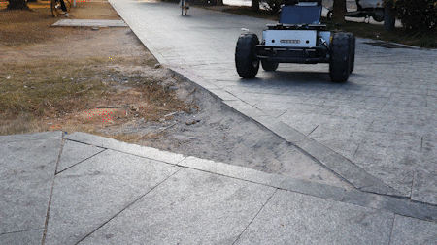
Course Outline
Mini Project
A group project on applications of kinematics, dynamics, and control for a few typical robots to be released later.

Slide 6
Assessment
Open-book Exam: 30% of the total mark with the duration of 1 hour.
Continual Assessment: 35% of the total mark is from the Mini Project.
Another 35% of the total mark is from Prof. Chui Chee Kong’s part.

Slide 7
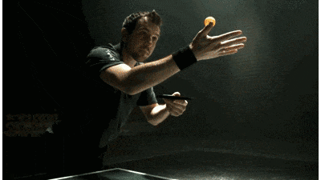
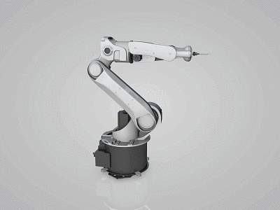
1. Review of Kinematics
General Features of Robots
Rigid links are connected by either revolute or prismatic joints;
Each link is connected by, at most, two others;
Each joint-link pair constitutes one DOF;
n joint-link pairs = n DOFs;
......

Slide 8
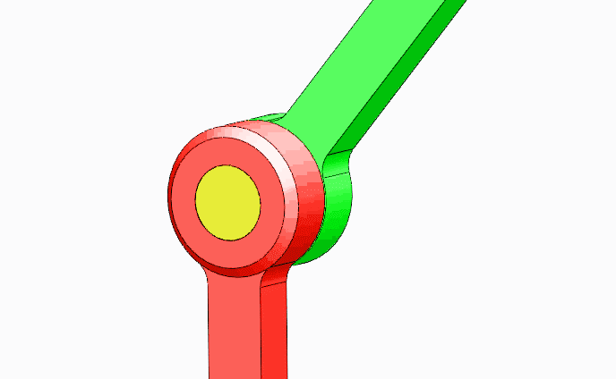
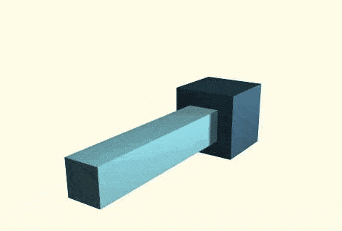
1. Review of Kinematics
Two Basic Joints
Revolute Joint
Prismatic Joint

Slide 9
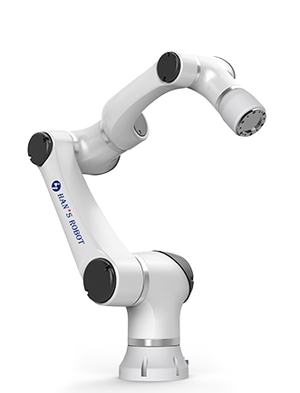
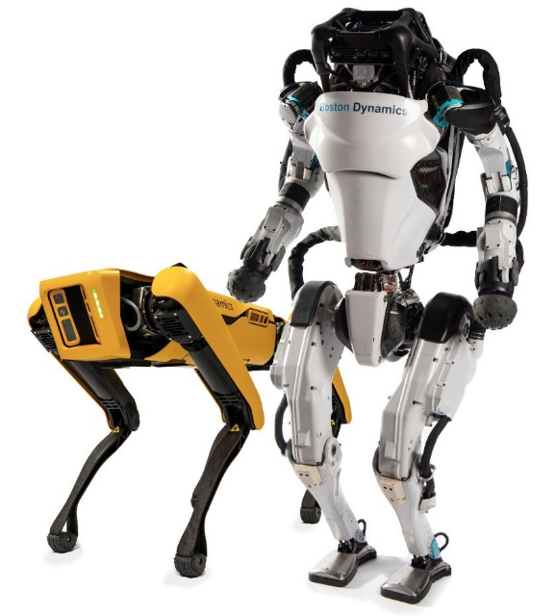
1. Review of Kinematics
Based on such two types of joints, different kinds of robots have been designed and developed.
Han*s Robot
Boston Dynamics Robot

Slide 10
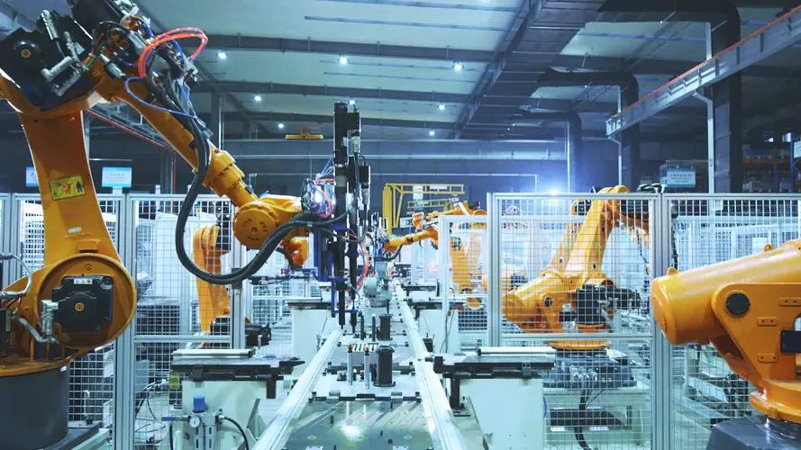
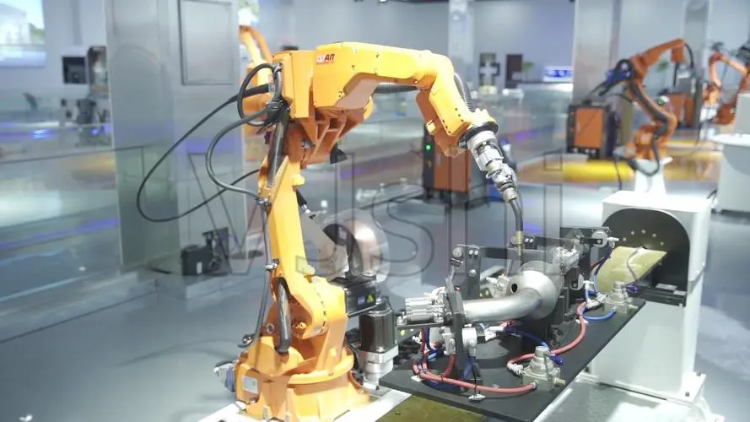
1. Review of Kinematics
They have been widely applied in industrial automation for painting, welding, assembly, ironing, palletizing and so on.

Slide 11
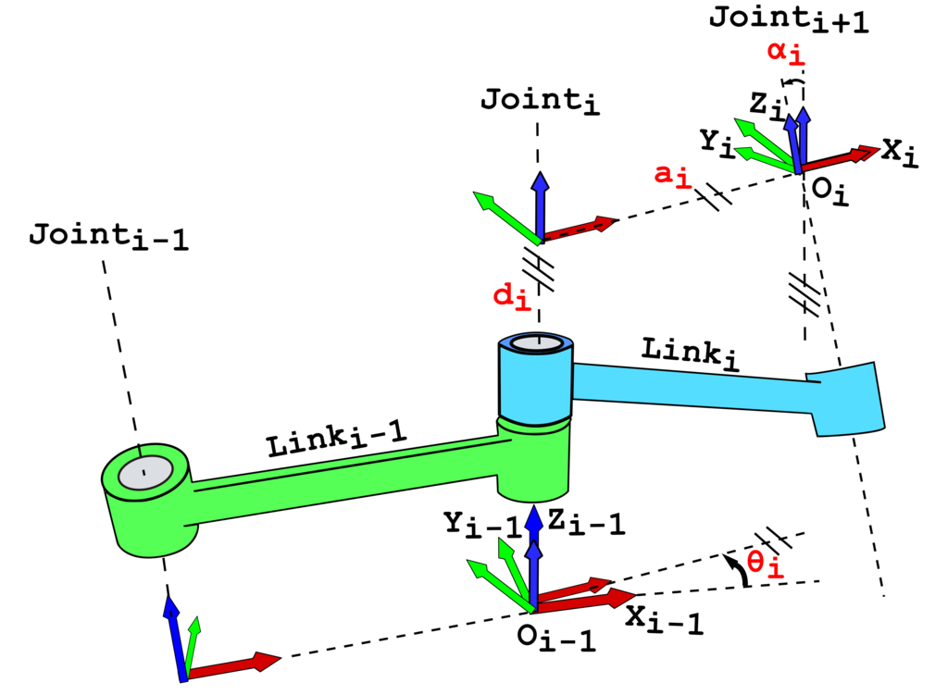
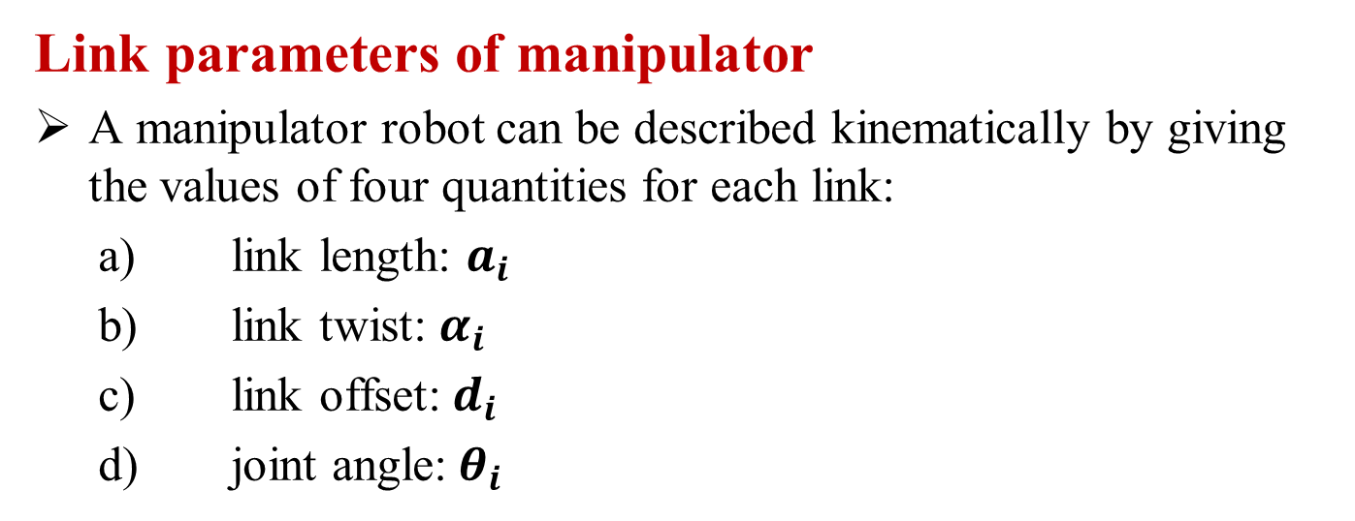
1. Review of Kinematics
Link parameters of manipulator
A manipulator robot can be described kinematically by giving the values of four quantities for each link:
link length: $a_{i}$
link twist: $α_{i}$
link offset:${ d}_{i}$
joint angle:${ θ}_{i}$
The Denavit-Hartenberg Notation

Slide 12
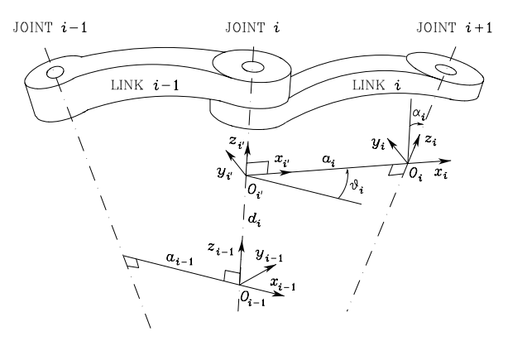
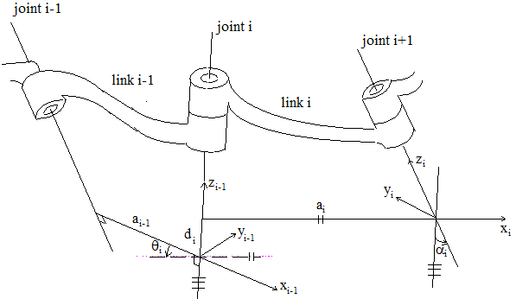
1. Review of Kinematics
Craig, pp. 66:
Siciliano, pp. 62
Different Assignment of Link Coordinate Systems
(The Denavit - Hartenberg Notation)
Fu, et al, pp. 39

Slide 13
1. Review of Kinematics
Note that:
Extend to get , and use right-handed rule to
obtain ;
Frame i is considered firmly attached to link i but at
joint i+1;
When , is chosen normal to .

Slide 14
1. Review of Kinematics
Formulation of Denavit - Hartenberg (D - H)
Transformation matrix,
Fu, et al:
Craig: (Different from Fu's)
where s means sin and c means cos.

Slide 15
1. Review of Kinematics
Properties:
(i)
(ii)
Compound Transform
(iii)
Inverting a Transform

Slide 16
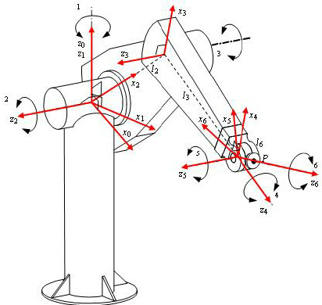
1. Review of Kinematics
Direct Kinematics:
i. Find
ii. Compute
PUMA560
Inverse Kinematics:
Algebraic: Tackle the equation directly
Geometric: Decompose spatial geometry to 2D...
Numerical ...

Slide 17
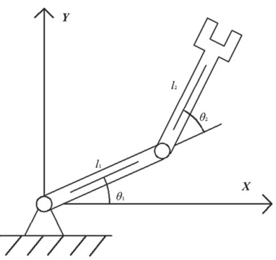
Example: Inverse Kinematics
i. Algebraic: Tackle the equation directly
For two-link planar robot, the following direct relationship is obtained.

Slide 18
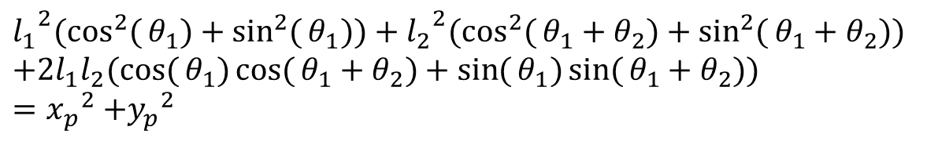
Example: Inverse Kinematics
Tackle the equation directly
(1.1.1)
The square of Eq. (1.1.1) is
(1.1.2)
(1.1.3)
Adding Eq. (1.1.2) with Eq. (1.1.3) , we have
$${l_{1}}^{2}(\cos^{2}{(}θ_{1})+\sin^{2}{(}θ_{1}))+{l_{2}}^{2}(\cos^{2}{(}θ_{1}+θ_{2})+\sin^{2}{(}θ_{1}+θ_{2})) \\ +2l_{1}l_{2}(\cos{(}θ_{1})\cos{(}θ_{1}+θ_{2})+\sin{(}θ_{1})\sin{(}θ_{1}+θ_{2}))={x_{p}}^{2}\text{ +}{y_{p}}^{2}$$
(1.1.4)

Slide 19
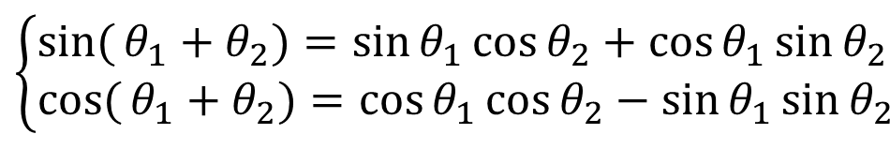
Example: Inverse Kinematics
$$\left\{\begin{aligned}&\sin{(}θ_{1}+θ_{2})=\sin{θ_{1}}\cos{θ_{2}}+\cos{θ_{1}}\sin{θ_{2}} \\ &\cos{(}θ_{1}+θ_{2})=\cos{θ_{1}}\cos{θ_{2}}−\sin{θ_{1}}\sin{θ_{2}}\end{aligned}\right.$$
Since
we have
Eq. (1.1.4) becomes
(1.1.5)

Slide 20
Example: Inverse Kinematics
Eq. (1.1.5) can be rewritten as
we have

Slide 21
Example: Inverse Kinematics
Further, let us re-write Eq. (1.1.1) as
(1.1.6)
(1.1.7)
Adding Eq. (1.1.6) with Eq. (1.1.7) , we have
(1.1.8)

Slide 22
Example: Inverse Kinematics
Since
we have
Eq. (1.1.8) becomes
(1.1.9)

Slide 23
Example: Inverse Kinematics
Substituting Eq. (1.1.5) into Eq. (1.1.9), we obtain
(1.1.10)
Eq. (1.1.10) can be rewritten as
we have

Slide 24
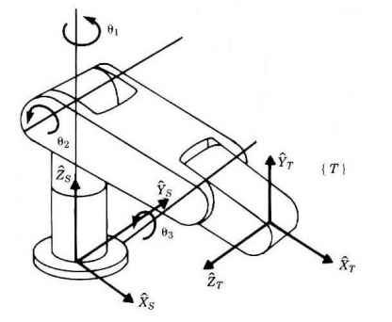
Example: Inverse Kinematics
ii. Geometric: Decompose spatial geometry to 2D
Consider the RRR robot
The position of the wrist in space:

Slide 25
Example: Inverse Kinematics
Decompose spatial geometry to 2D
The planar geometry - top view of the robot

Slide 26
Example: Inverse Kinematics
Decompose spatial geometry to 2D
The planar geometry - side view of the robot

Slide 27
Example: Inverse Kinematics
By the law of cosines, we have
Interior angle
Exterior angle

Slide 28
Example: Inverse Kinematics
iii. Numerical: Iterative solution
Consider the two-link planar robot again. Differentiating
results in
which is formulated as
Then we have
Given , we further have
(J is the Jacobian matrix)

Slide 29
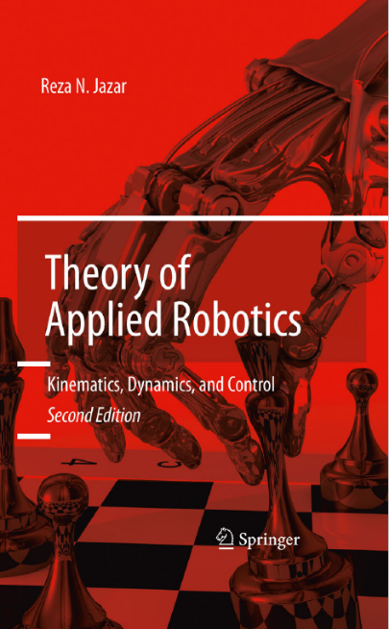
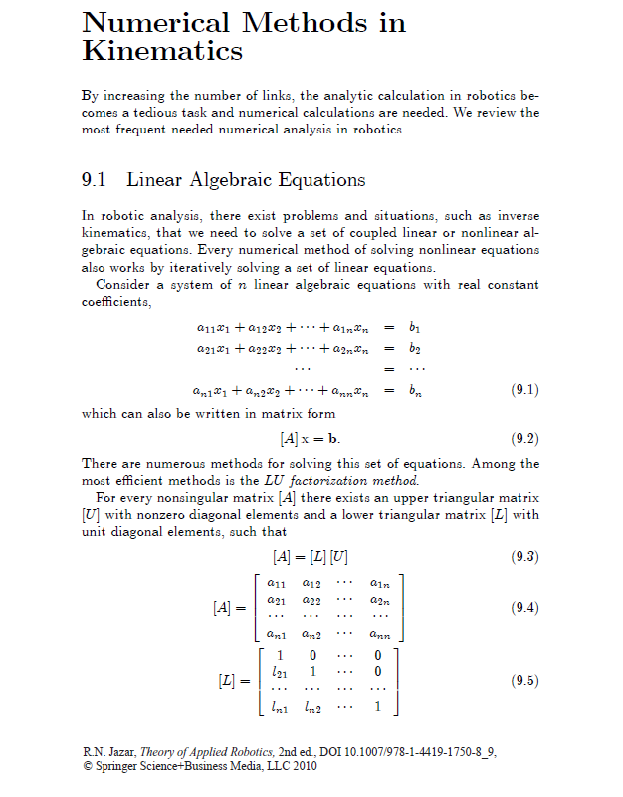
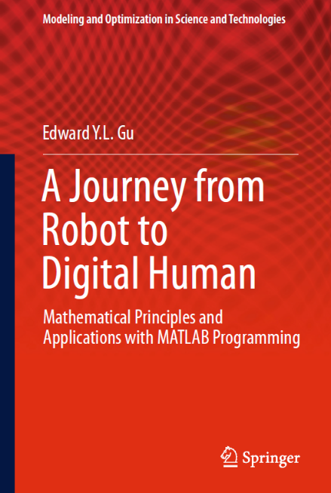
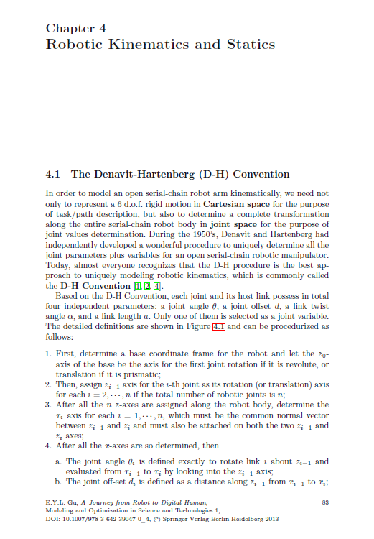
Example: Inverse Kinematics
iii. Numerical: Reference for completeness and interested students.
[1] Jazar, Reza N. Theory of applied robotics: kinematics, dynamics, and control. Springer Science & Business Media, 2010.
[2] Gu, Edward YL. A journey from robot to digital human: mathematical principles and applications with MATLAB programming. Vol. 1. Springer Science & Business Media, 2013.

Slide 30
Chapter I: Learning Outcomes
Understand structure and general features of robots
Understand the formulation of Denavit – Hartenberg
Understand direct kinematics and inverse kinematics
Capabilities:
Be able to solve direct and inverse kinematics for typical robots
Can think, do information search and solve for more complex demands, such as with rotations.

Slide 31


Newly Developed Robots
X1 Mobile Robot
by NUS
Hanson Robotics-Sophia

Slide 32
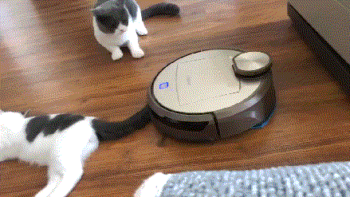
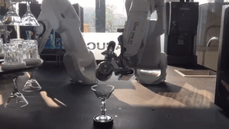
Newly Developed Robots
A Vacuum Cleaning Robot
A Bartender Robot

Slide 33
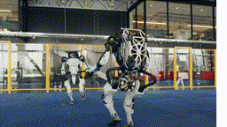
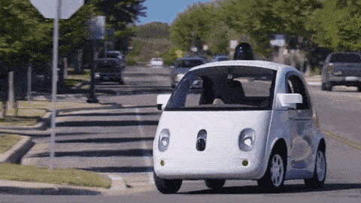
Newly Developed Robots
Boston Dynamics
Robot-driven Vehicle

